Slide 1

DEPARTMENT OF CSE
Group name: dextrous

Slide 2
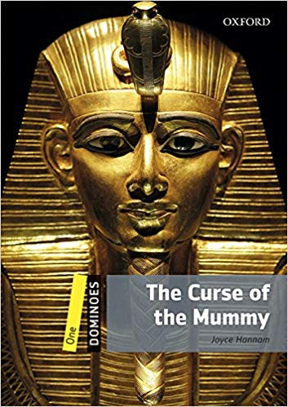
ENGLISH FOR ACADEMIC PURPOSE – 1 TOPIC : THE CURSE OF THE MUMMY
NAME | ID - NO
Md. Nasir Ahmed | 193002105
Md. Jakirul Islam | 193002101
Md. Al Sayem | 193002080
Md. Naimur Rahman | 193002090
Tasfin Islam | 193002162

Slide 3
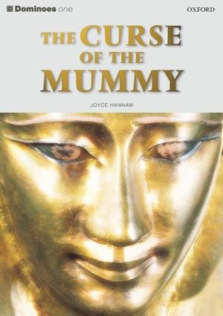
I am going to talk about the curse of the mummy by Joyce Hannam.

Slide 4
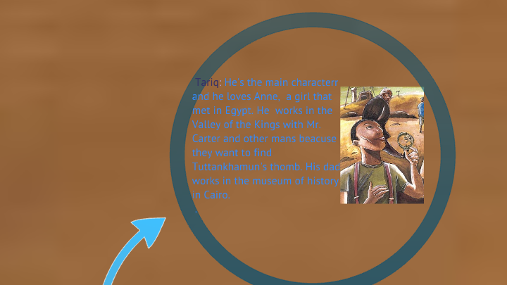

Slide 5
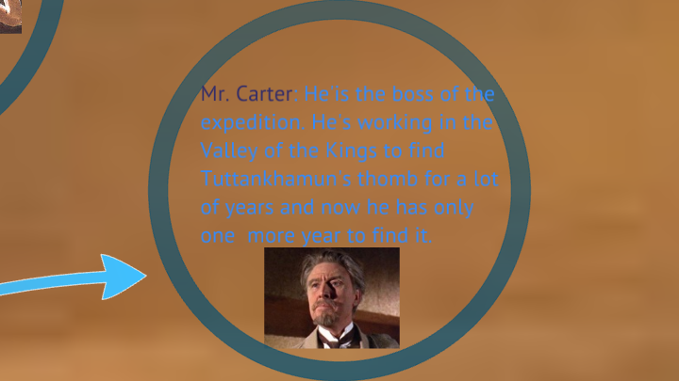

Slide 6
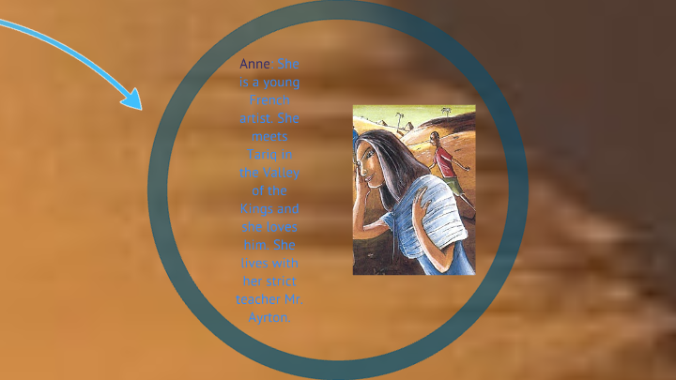

Slide 7
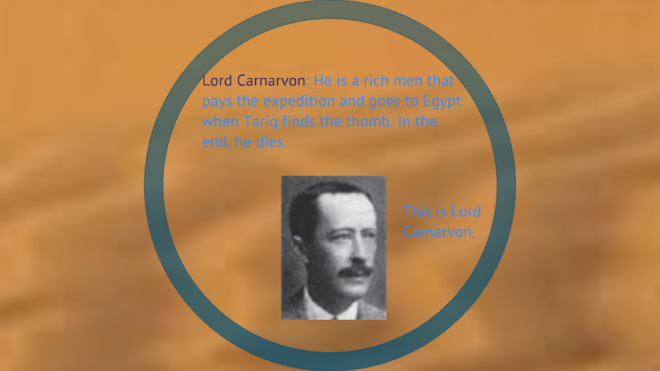

Slide 8
The story is about a boy called Tariq. He is in the Valley of the Kings with Mr Carter to find the tomb of Tutankhamun, but the work is not easy, because they have only one year to find the tomb.

Slide 9
One day some visitors came to the Valley of the Kings. Tariq met a beautiful girl called Anne. Four months later, Tariq found a step in the sand, then they dug very quickly and they found a door.

Slide 10
The door was not open because had seals on it, the seals of Tutankhamun. Some people think the spirit of Tutankhamun came to kill then but Tariq is not afraid. Lord Carnavaron and his daughter came to open the door.

Slide 11
The next day they open the door, they saw a lot of beautiful things and a golden shrine. When they open the shrine, there was the mummy of Tutankhamun, now Tariq is afraid of the spirit of Tutankhamun because a lot of people have died.

Slide 12
At the end Tariq came back to Cairo. Six or seven years later Tariq saw Anne in the museum and then they worked there. And Tariq and Anne got married.

